Slide 1




Cybercrime and Digital Forensics (COM622)
Department of Science & Engineering
Solent University
Week 6 Lecture: File system and Hard Disk Volume and Partitions
Dr Daniel Olabanji

Slide 2

Session Overview
Booting code
Examine File system and Hard Disk Volume
Understanding of Partitions
Data acquisition Revisit

Slide 3
File systems
A file system is a concept of organising data on storage devices and provides an understanding on the ways of storing, retrieving and management of computer files.
Functions:
Data storage and retrieval
Metadata management
Access control (Radius and active directory)
Common File Systems:
Windows: NTFS, FAT32, exFAT
Linux: ext3, ext4, XFS, Btrfs
macOS: HFS+, APFS

Slide 4
File systems Architecture
A file systems architecture can be defined as how data is stored, organised, and accessed on a storage device. It includes several layers and components that work together to manage files and directories efficiently.
Components of File System
Superblock: status (mounted/unmounted), size, Location)
Index Nodes: size, ownership, permissions, timestamps)
Data Blocks: file stored data block, pointers either direct or indirect and double/triple indirect)
Directory Structure: Root director, hierarchical structure, filenames mapping

Slide 5
Booting and booting code
Booting: is the process of starting a computing as initiated by the hardware such as the on/off button on the computer of by a software command.
Booting Code is a set of "instructions" that are run by a computer when it is starting up. The boot code helps the computer prepare the system for loading and running an operating system, but boot code itself is usually not operating system specific.

Slide 6
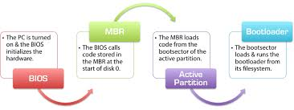
Booting and booting code cont.
On power on the processor execute code from BIOS,
The drives and hardware devices are searched and set,
The BIOS code examines, in some configuration order, the floppy drives, CD and
Hard disk and locate the first sector code to execute.
The code in sector 0 of a bootable disk forces the processor to process the partition
table and locate the bootable partition, where the OS ( in this case Window) is found.

Slide 7
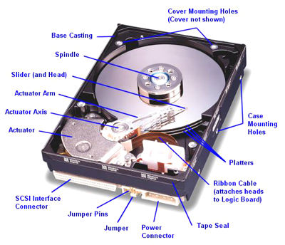
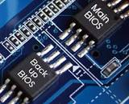
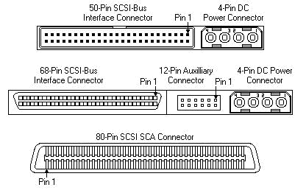
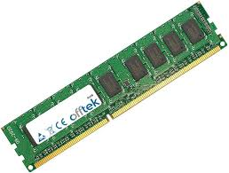
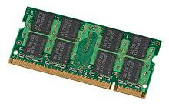
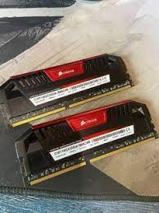

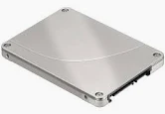

Booting and booting code Hardware revisit
Bios
Hard disk
Memory

Slide 8
Hard drive
Hard drives could be described as passive memory devices
Internal and External hard drive
Hard drive Capacity
Hard drive type
HDD (Hard disk drive
SSD (Solid State Drive)
SATA (Serial Advanced Technology Attachment)

Slide 9
Disk Volume
Volumes are used to store file system and data structures
Volumes are collections of addressable sectors that an Operating System (OS) or applications can use for data storage e.g. Hard disk
Partitions are collections of consecutive sectors in a volume. (Sometimes partitions are confused with volumes)
The purpose of the partitions is to organise the layout of the volume
Partition system depends on the OS and not the hardware ATA/IDE or SCSI volume.

Slide 10
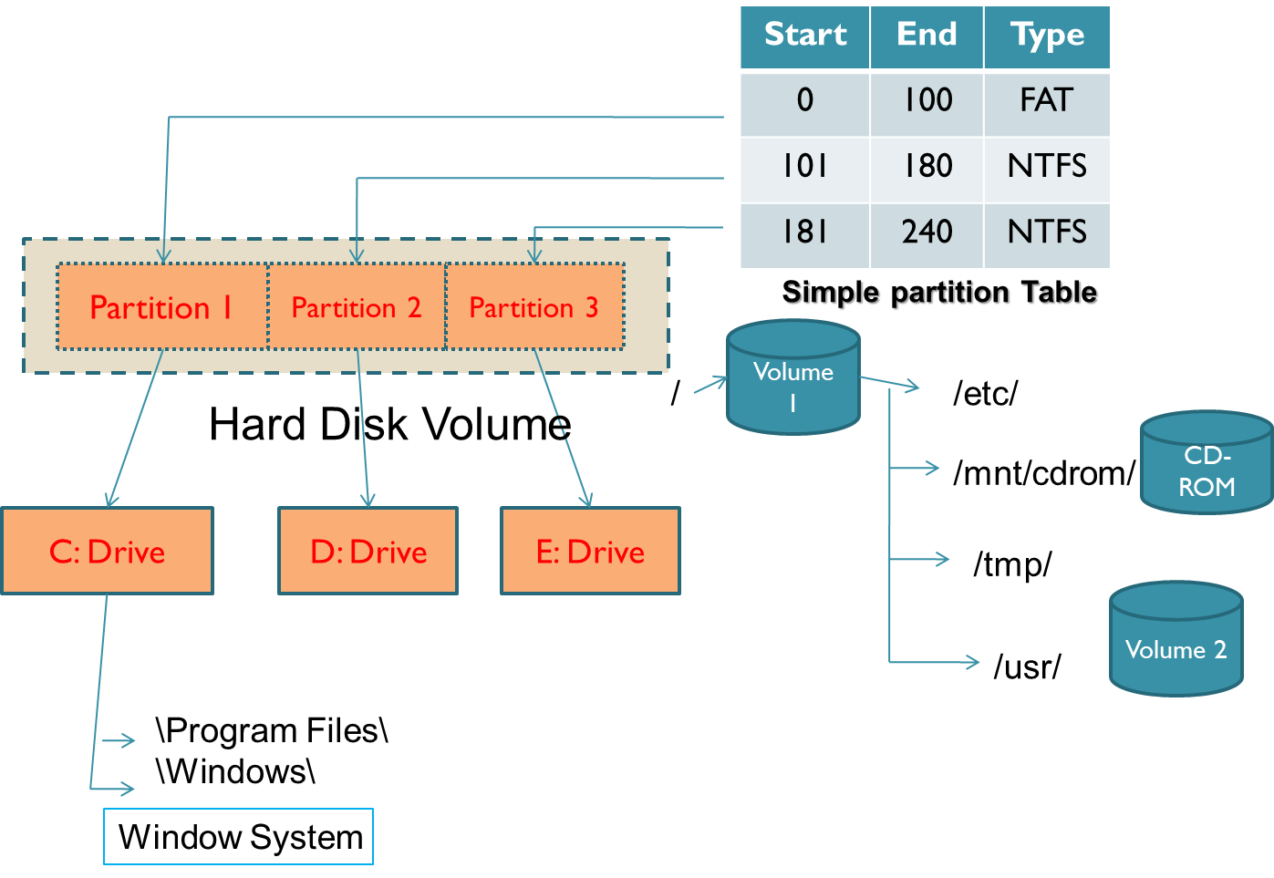
Disk Volume (Partition)

Slide 11
Disk Volume
Address
Label:
0
1
445
461
477
493
509
…
…
<-16->
Count:
1
2
446
462
478
494
510
55aa
sudo dd if=/dev/sda bs=1 count=16 skip=462 | xxd
Gets the content of the 2nd partition table.
sudo dd if=/dev/sda bs=1 count=2 skip=510 | xxd
Gets the signature 55aa
Size = bs*count (in bytes to read)
Size = bs * Skip ( in bytes to skip)

Slide 12
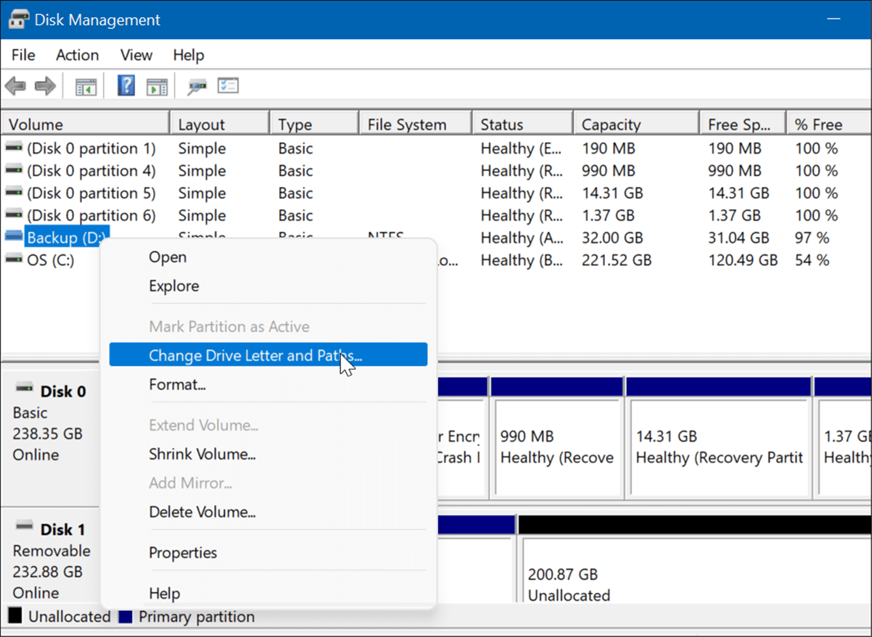
Disk partitions tools
Windows: Disk Management, diskpart
Linux: fdisk, parted, lsblk, mkfs

Slide 13
DoS Partition Table
Byte Range | Description | Essential
0-445 | Boot Code | No
446-461 | Partition Entry 1 | Yes
462-477 | Partition Entry 2 | Yes
478-493 | Partition Entry 3 | Yes
494-509 | Partition Entry 4 | Yes
510-511 | (0xAA55) | No
Dos Partition Entries
Range | Description | Essential
0-0 | Bootable Flag | No (2)
1-3 | Start CHS ( 8-bit head), (10-bit Cylinder), (6-bit sector) | Yes
4-4 | Partition Type | No (1)
5-7 | End CHS | Yes
8-11 | Start LBA | Yes
12-15 | Size in Sector | Yes

Slide 14
Apple Ios Partitions
The partition can be found in latest Apple laptop, desktops running OS X, older systems running Macintosh 9, iPod devices.
The firmware has code to process the tables, unlike DOS.
The first table of the partition map is an entry for itself that specifies how many partitions are there.
In Apple systems everything belongs to a partition drivers etc.. Except sector 0.

Slide 15
Apple (MAC) Partitions
Address |  | Size in bytes | Contents | Required?
Decimal | Hex
0 | 0x0000 | 1 | signature1 (ASCII value "P") | No
1 | 0x0001 | 1 | signature2 (ASCII value "M") | No
2–3 | 0x0002 | 2 | reserved | No
4–7 | 0x0004 | 4 | number of partitions (total) | Yes
8–11 | 0x0008 | 4 | starting sector of partition | Yes
12–15 | 0x000C | 4 | size of partition (in sectors) | Yes
16–47 | 0x0010 | 32 | name of partition (fixed ASCII right-side NULL padded) | No
48–79 | 0x0030 | 32 | type of partition (fixed ASCII right-side NULL padded) | No
80–83 | 0x0050 | 4 | starting sector of data area in partition | No
84–87 | 0x0054 | 4 | size of data area in partition (in sectors) | No
88–91 | 0x0058 | 4 | status of partition | No
92–95 | 0x005C | 4 | starting sector of boot code | No
96–99 | 0x0060 | 4 | size of boot code (in bytes) | No
100–103 | 0x0064 | 4 | address of bootloader code | No
104–107 | 0x0068 | 4 | reserved | No
108–111 | 0x006C | 4 | boot code entry point | No
112–115 | 0x0070 | 4 | reserved | No
116–119 | 0x0074 | 4 | boot code checksum | No
120–135 | 0x0078 | 16 | processor type (fixed ASCII right-side NULL padded) | No
136–511 | 0x0088 | 376 | reserved | No
Source: Wikipedia

Slide 16
Data Acquisition revisit
Acquisition occurs during the preservation phase of an investigation
Data must be collected properly, otherwise their values as legal evidence will be diminished .
If data are not collected immediately from the suspect machine, it could be lost and not recognized as evidence
Remember the law and regulation

Slide 17
Data Acquisition revisit
A dead Acquisition
  Data from the suspect machine is copied after booting from a trusted CD or floppy, (CAINE)
Live Acquisition
    The OS of suspect machine is still running and used to copy data. It is possible that the suspect has modified the OS and other applications to give a false data.
  Tools like toolkits might just do that.
Handling Errors
Most tools when they found bad sectors, they log its address and write 0’s for data that could not be read.

Slide 18
Reference
  Carrier Brian (2005) “ File System Forensic Analysis”, Addison-Wesley
  Casey Eoghan (2004) “Digital Evidence and Computer Crime” 2nd Ed London Academic Press
  Mandia Kevin, Chris Prosise, Matt Pepe (2003) “ Incident Response and Computer Forensics” MacGraw Hill
  Sammes, Tony and Brian Jenkinson (2000) “Forensic Computing: A Practitioner’s Guide” New York: Spring-Verlag,

